Slide 1
CREST: Convolutional Residual Learning for Visual Tracking
Yibing Song¹, Chao Ma², Lijun Gong³, Jiawei Zhang¹, Rynson Lau¹, and Ming-Hsuan Yang⁴
¹City University of Hong Kong
²The University of Adelaide
³SenseNets Technology Ltd
⁴University of California at Merced

Slide 2
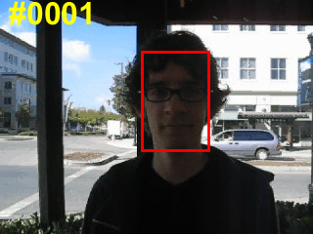
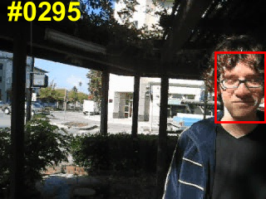
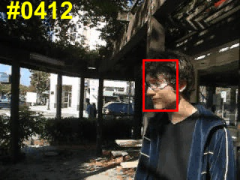
Introduction:
Single target object tracking:
We estimate target locations in the subsequent frames given its first frame state.

Slide 3

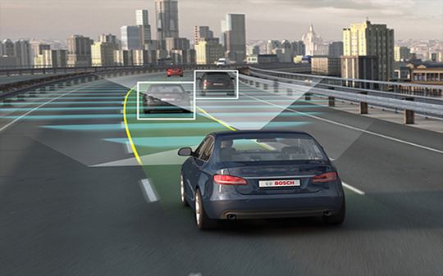
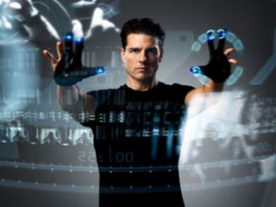
Applications:

Slide 4
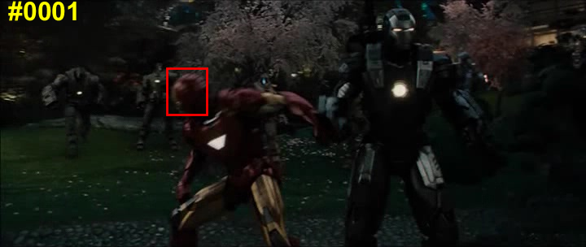
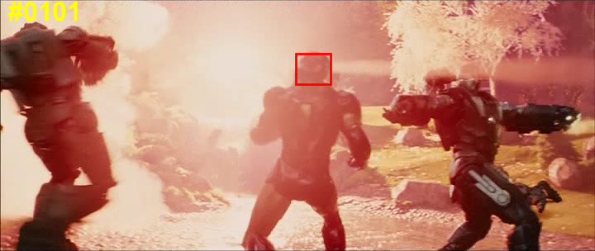
Challenges:
Illumination variations

Slide 5
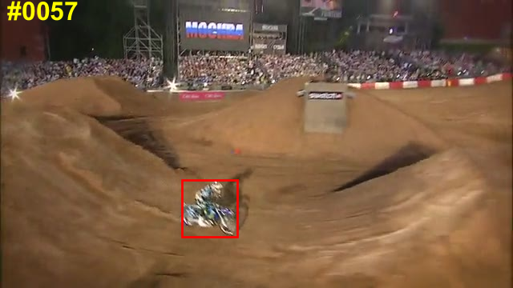
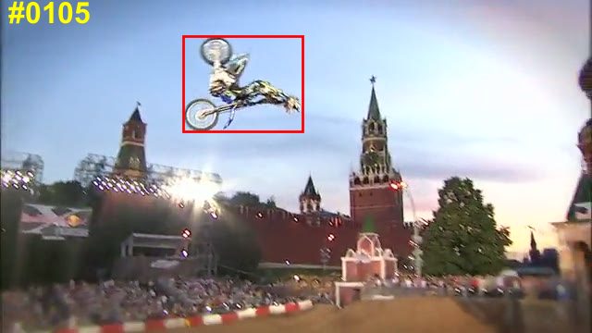
Challenges:
Object rotations

Slide 6
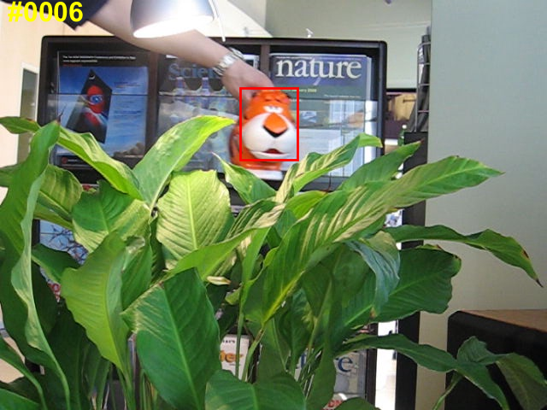
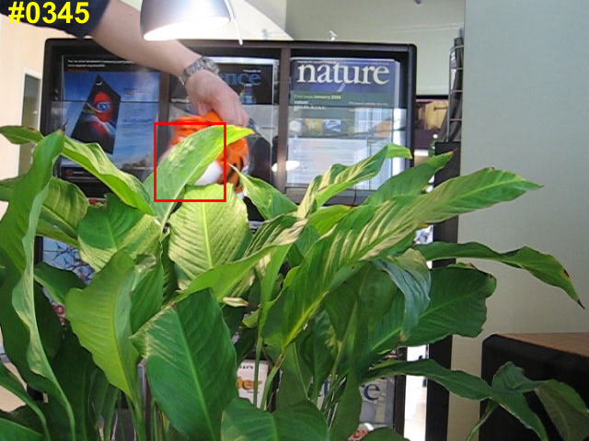
Challenges:
Occlusions

Slide 7
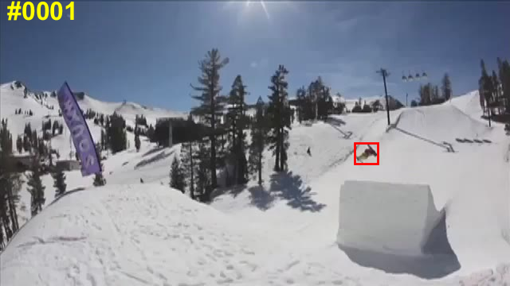
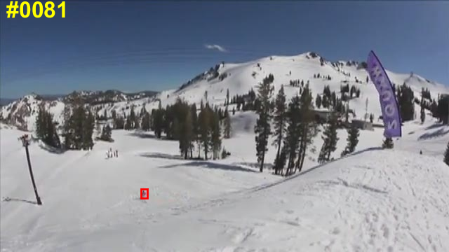
Challenges:
Low resolutions

Slide 8
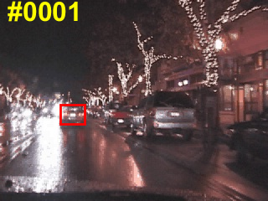
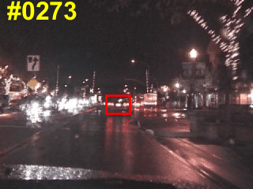
Challenges:
Background clutter

Slide 9
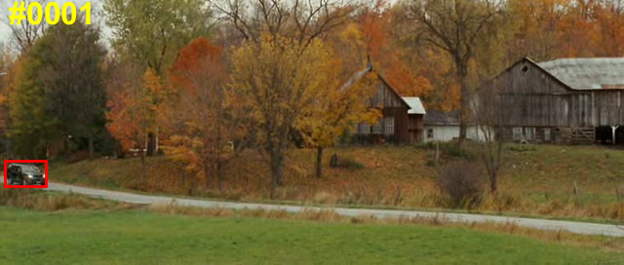
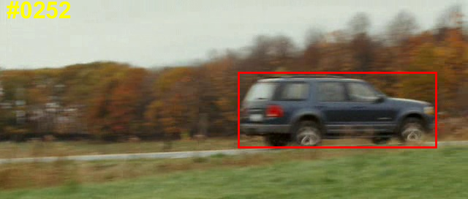
Challenges:
Scale variations

Slide 10
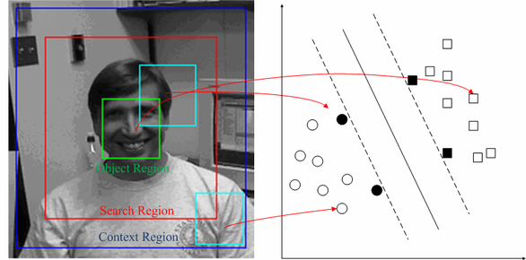
Prior arts:
Pro: Divide and conquer is accurate.
Tracking-by-detection framework
Con: Sparse sampling and redundancy.

Slide 11
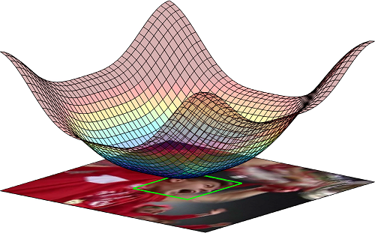
Prior arts:
Pro: One pass in the Fourier domain, dense predictions.
Correlation filter framework
Con: inaccurate pixel-wise prediction.

Slide 12
Intuition:
Existing correlation filter frameworks are empirically designed:
Filter weights training, model update, convolutional feature integration, etc.
The whole framework has not been optimized in an end-to-end form.
The deep architecture has not been fully exploited.
Why not integrate both as a whole?

Slide 13
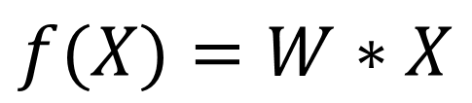
Review: Discriminative correlation filters
$$f(X)=W∗X$$
$$W^{⋆}={argmin }_{W}{||W∗X−Y||}^{2}+λ{||W||}^{2}$$
Objective function: ridge regression.
X: input features
$$W={(X^{T}X+λI)}^{−1}X^{T}Y$$
Y: ground truth gaussian label
W: correlation filter weight

Slide 14
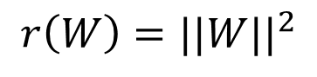
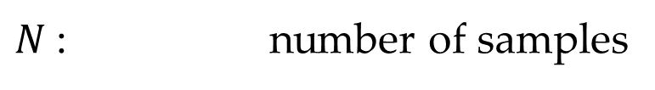
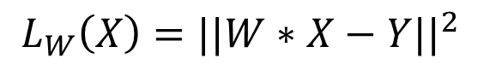
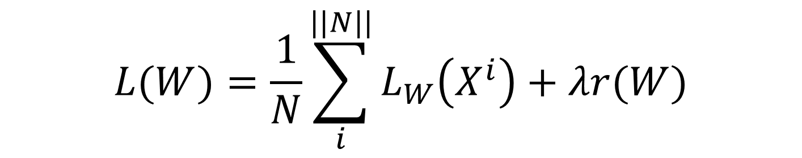
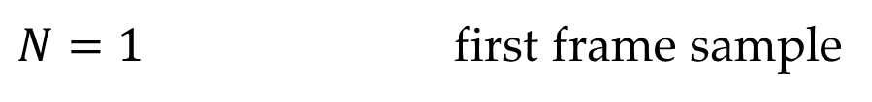
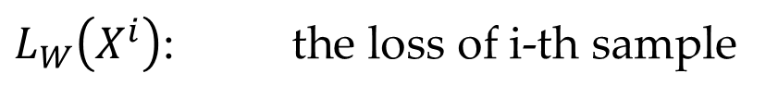
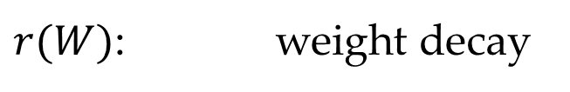
Review: L2 loss in the CNNs
$$L(W)=\frac{1}{N}\sum_{i}^{||N||}{L_{W}\left(X^{i}\right)}+λr(W)$$
We set:
$N$: number of samples
$N=1$ first frame sample
$L_{W}\left(X^{i}\right)$: the loss of i-th sample
$$L_{W}\left(X\right)={||W∗X−Y||}^{2}$$
L2 loss
$r(W)$: weight decay
$$r\left(W\right)={||W||}^{2}$$
Regularization term
W is the parameter of one convolutional layer
$$L(W)={||W∗X−Y||}^{2}+λ{||W||}^{2}$$

Slide 15
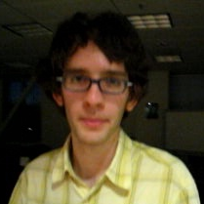
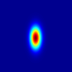
Our method: Formulation of correlation filter as one convolutional layer.
Feature Extraction
One conv layer: DCF
Feature map
Response map
End-to-end prediction and optimization

Slide 16
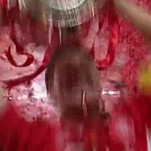
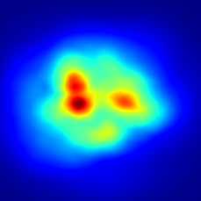
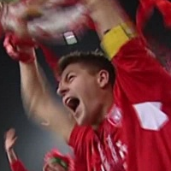
Our method: Observations

Slide 17
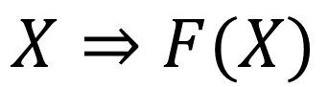
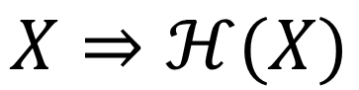
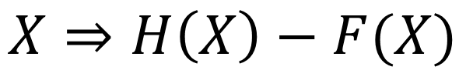
Our method: Intuition
$$X⇒ℋ(X)$$
Optimal ground truth prediction
$$X⇒F(X)$$
Practical prediction
$$X⇒H\left(X\right)−F(X)$$
Residual prediction

Slide 18
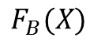
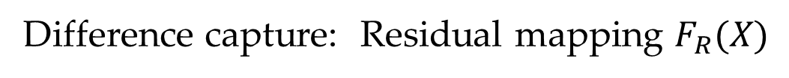
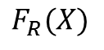
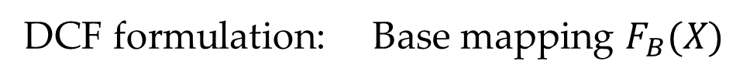
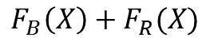
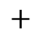
Our method: Residual layers
x
Weight Layer
$$F_{B}(X)$$
Relu
$$F_{R}(X)$$
Base Mapping
Weight Layer
Weight Layer
Residual Mapping
Relu
Weight Layer
$$+$$
$$F_{B}\left(X\right)+F_{R}(X)$$
DCF formulation: Base mapping $F_{B}(X)$
Difference capture: Residual mapping $F_{R}(X)$

Slide 19
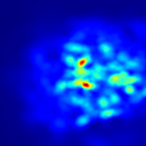
Our method: Residual layers
Input frame
Base output
Network output
Residual output

Slide 20
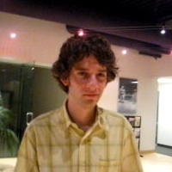

Our pipeline: Base and spatial residual learning
Base mapping: DCF
Feature Extraction
Frame T
Frame T
+
Feature map
Response Map
Residual mapping

Slide 21
Our pipeline: Temporal residual integration
Base mapping: DCF
Frame T
Frame T
Feature Extraction
+
Feature map
Frame 1
Frame 1
Spatial Residual
Response Map
Feature map
Temporal Residual

Slide 22
Experiments:
Benchmarks: OTB-2013, OTB-2015 and VOT-2016 datasets
Metric: Precision and success rate
Design: Internal and external analysis

Slide 23
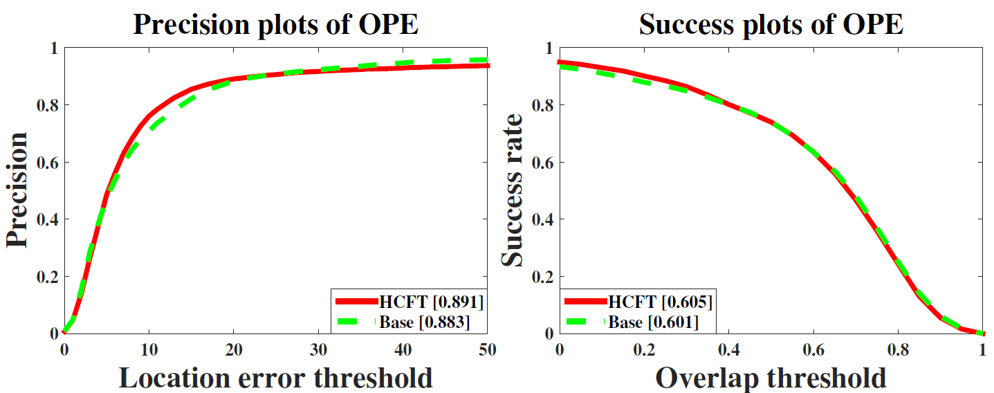
Experiments: Internal analysis
HCFT: Hierarchical Convolutional Features for Visual Tracking. Ma et al. ICCV 15.
Convolutional features + traditional DCF

Slide 24
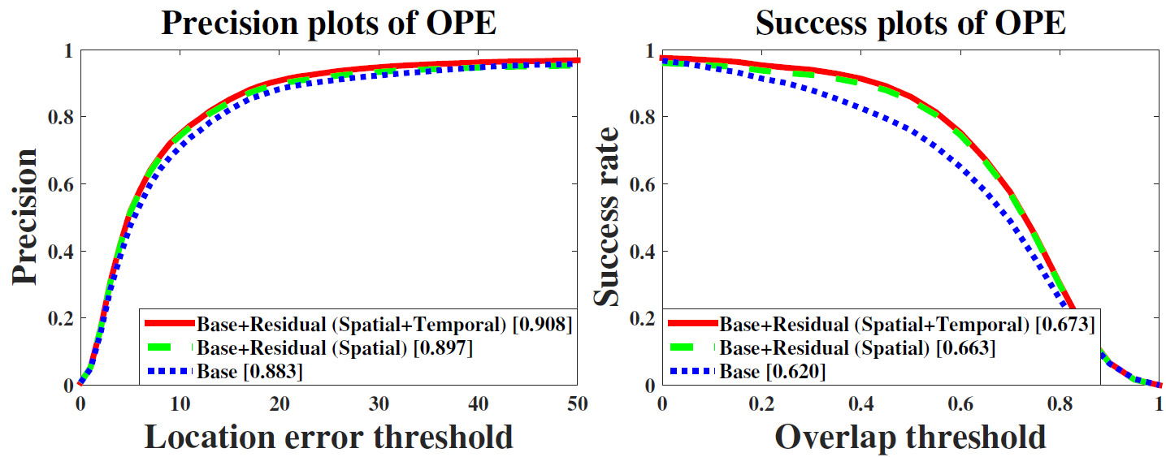
Experiments: Internal analysis

Slide 25
Experiments: External analysis
Comparison with state-of-the-art trackers
C-COT Beyond correlation filters: Learning continuous convolution operators for visual tracking. ECCV 2016
SINT Siamese instance search for tracking. CVPR 2016
SRDCFdecon Adaptive decontamination of the training set: A unified formulation for discriminative visual tracking CVPR 2016
MUSTer Multi-store tracker (muster): A cognitive psychology inspired approach to object tracking CVPR 2016
SRDCF Learning spatially regularized correlation filters for visual tracking ICCV 2015
LCT Long-term correlation tracking CVPR 2015

Slide 26
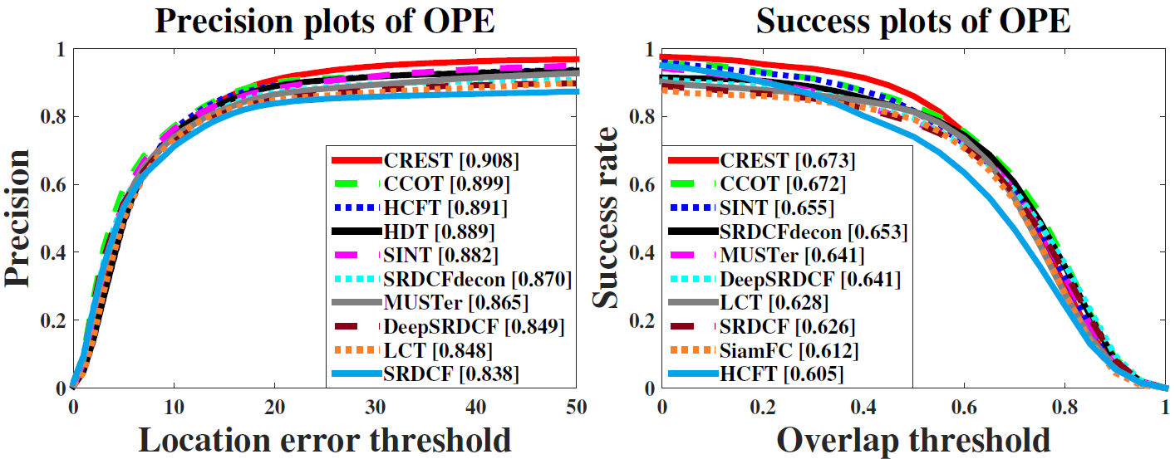
Experiments: Performance evaluation on the OTB 2013 dataset.

Slide 27
Take-home messages:
1. Correlation filter is a light-weight state-of-the-art framework for visual object tracking.
2. We formulate DCF as one convolutional layer for end-to-end training and prediction.
3. We apply residual learning to reduce model degradation via appearance variations.
4. State-of-the-art performance on the benchmark datasets.

